Slide 1

Team Member
Nguyễn Hoàng Tài Minh
Hà Minh Chiến
Phan Quốc Khôi
Nguyễn Luân
Nguyễn Cao Minh Triết
Nguyễn Ngọc Khánh

Slide 2

WHY WE CHOOSE INTELLIJ IDEA?

Slide 3


IntelliJ IDEA is a fully featured IDE developed by JetBrains. This IDE supports many languages from Java, Kotlin, Scala, Android, Mercurial, Groovy …

Slide 4

Features which make IntelliJ IDEA a truly intelligent

Slide 5
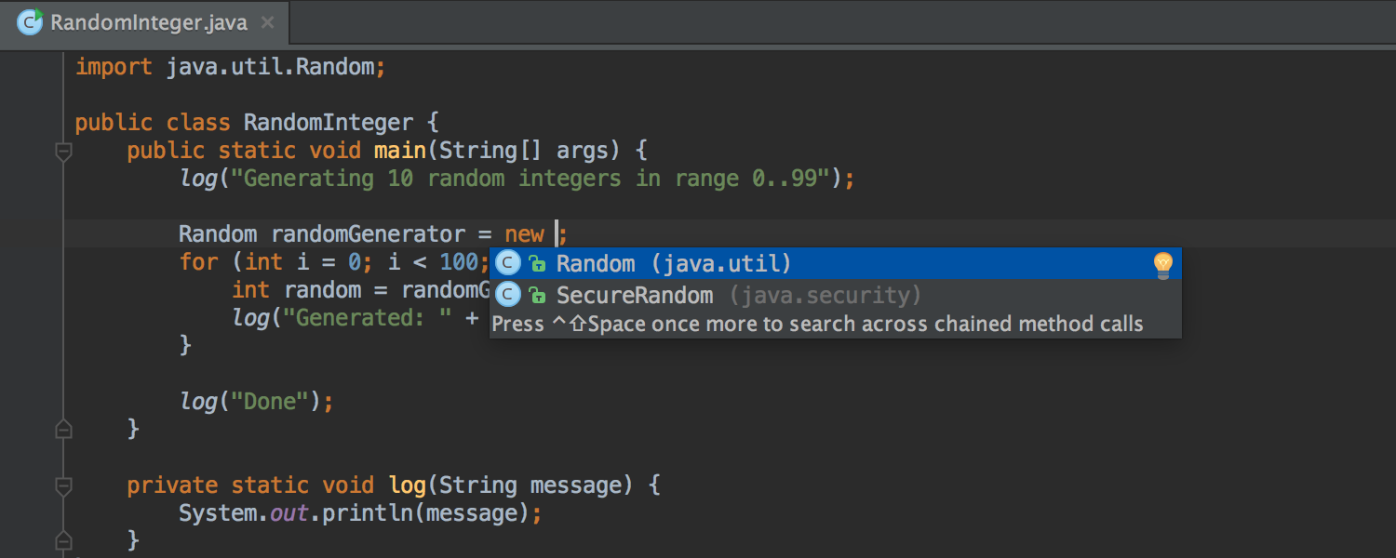
Completion
IntelliJ IDEA brings you several completion types that are really something, because they are based on the deep code intelligence mentioned earlier, and therefore are able to save you a lot of time (and typing.)

Slide 6
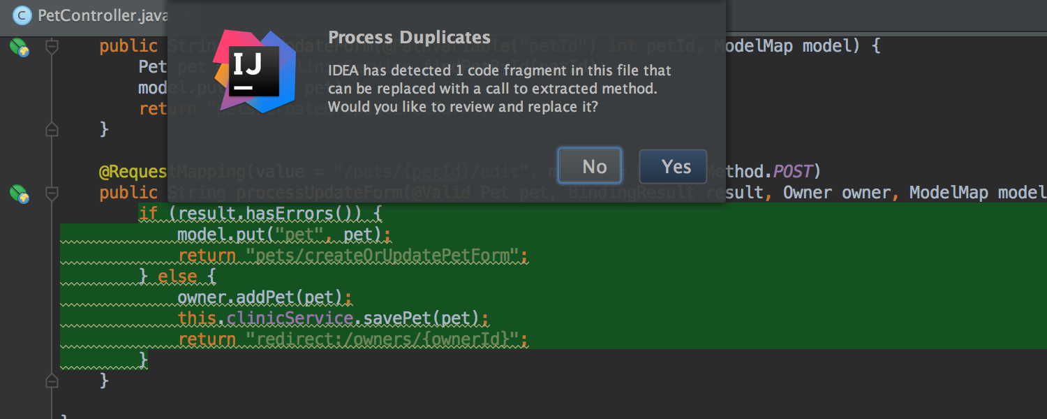
Detecting duplicates
IntelliJ IDEA knows your code so well it can detect duplicate blocks on the fly.
If you extract a variable, constant, or method, the IDE will check if there are other similar code within the scope that could be replaced with the new variable, constant, or method as well.

Slide 7
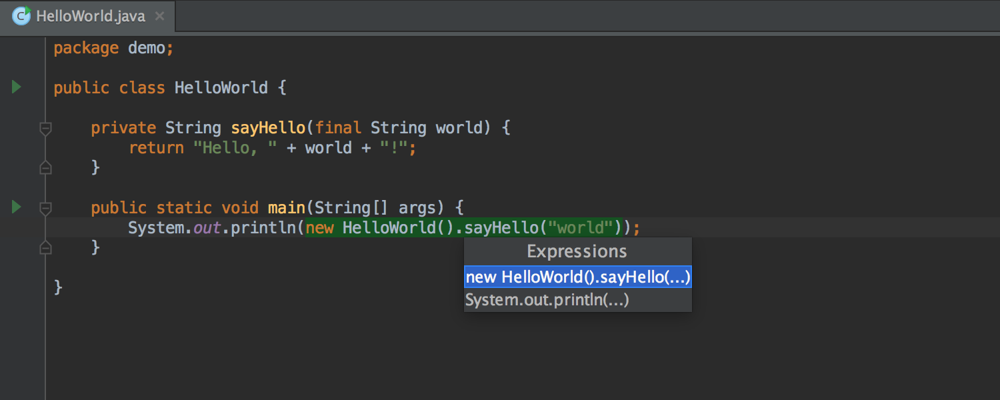
Undo refactorings
IntelliJ IDEA can easily rollback even the most complicated refactorings – with just one click. So it’s perfectly safe to experiment with the code in any way you like.
Selection
In the most cases, IntelliJ IDEA will guess the statement automatically or will offer you to choose from a list of available variants.

Slide 8
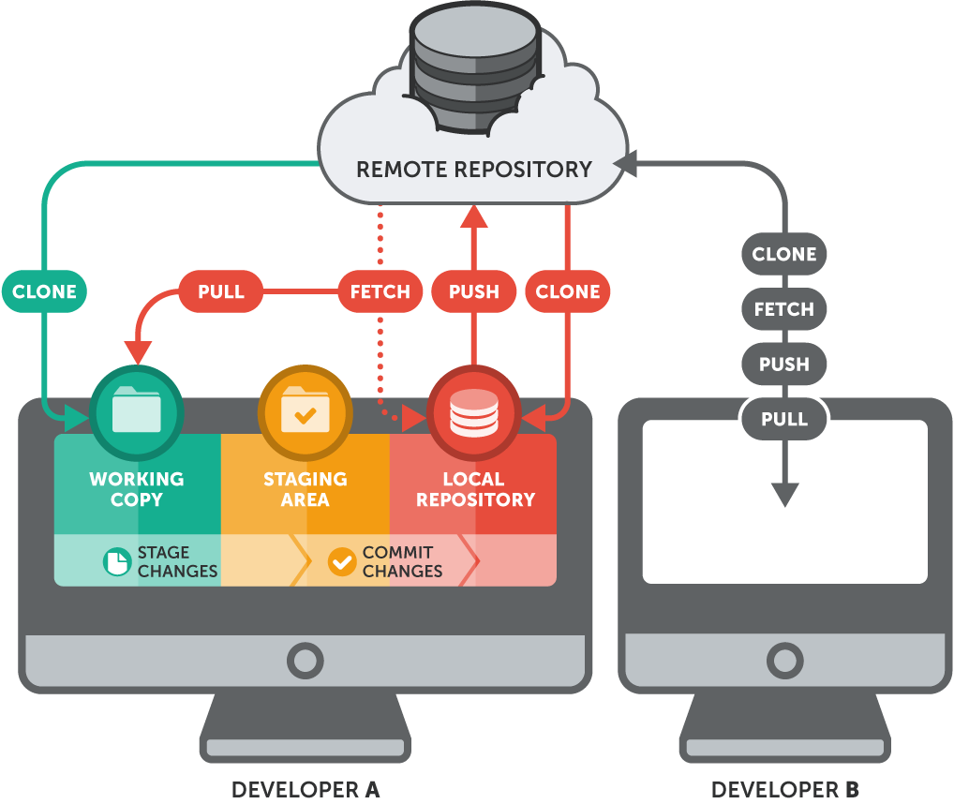
OPERATING PRINCIPLES

Slide 9
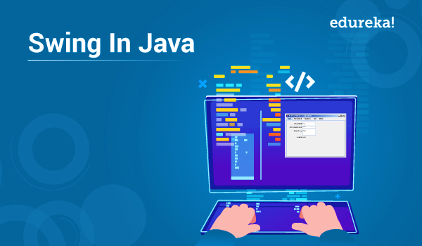
What is Swing?
Swing API is a set of extendable GUI parts to ease the developer’s life to form JAVA primarily based Front End/GUI Applications.
It turns on prime of AWT API and acts as a replacement of AWT API since it’s nearly every management comparable to AWT controls. Swing part follows a Model-View-Controller design to meet the subsequent criteria.

Slide 10
Swing Feature
A single API is to be adequate to support multiple look and feel.
API is to be model driven in order that the best level API isn’t needed to own information.
API is to use the Java Bean model in order that Builder Tools and IDE will give higher services to the developers to be used.

Slide 11

What is JavaFX?
JavaFX may be a GUI toolkit for Java (GUI is brief for Graphical User Interface). JavaFX makes it easier to form desktop applications and games in Java. JavaFX has replaced Swing because of the suggested GUI toolkit for Java. What is more, JavaFX is additional consistent in its style than Swing and has additional options. It’s additional fashionable too, sanctioning you to style GUI victimization layout files (XML) and elegance them with CSS, similar to we tend to are accustomed to network applications.

Slide 12
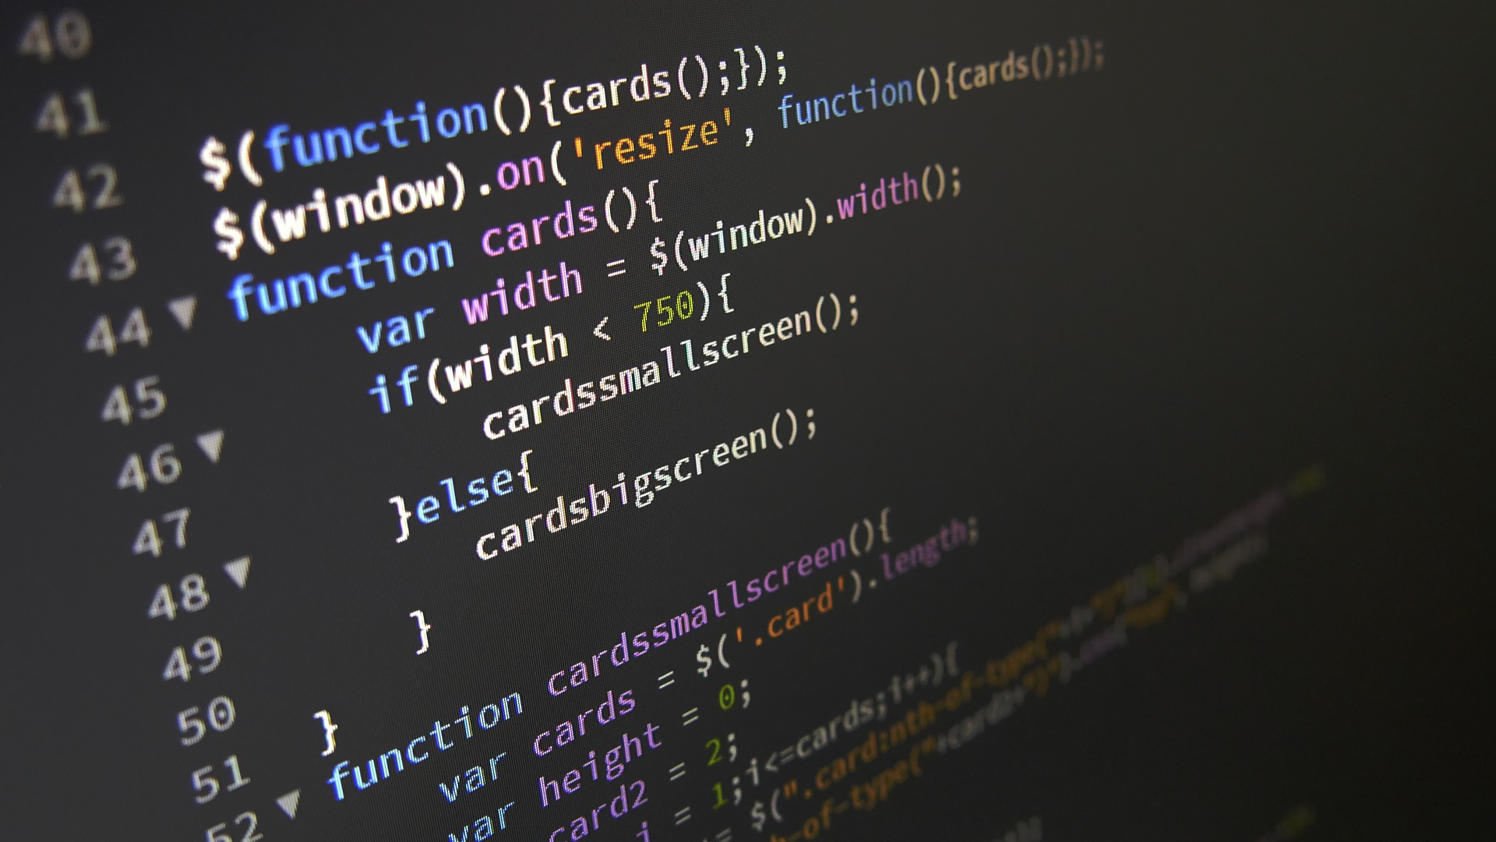
JavaFX Feature
JavaFX comes with an oversized set of intrinsic GUI parts, like buttons, text fields, tables, trees, menus, charts and far additional. That saves you tons of your time once building a desktop application.
JavaFX parts are often styled using CSS, and you’ll be able to use FXML to compose a GUI rather than doing it in Java code. This makes it easier to quickly place a GUI along, or amendment the appearance or composition while not having to play within the Java code.

Slide 13
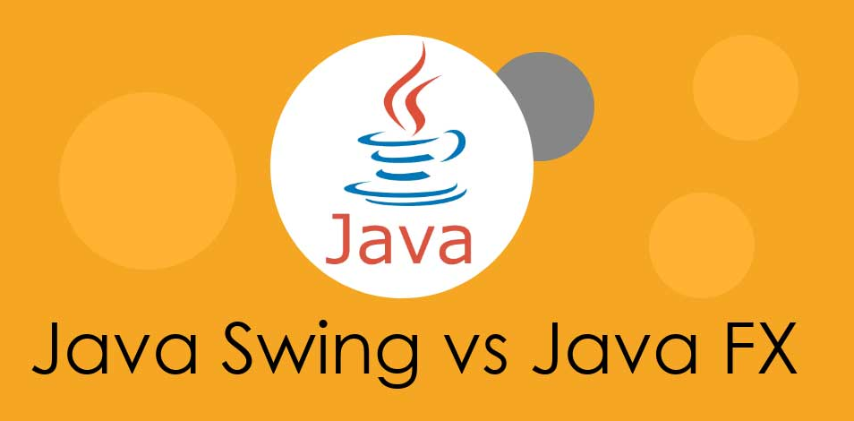
Why we choose JavaFX instead of Swing?

Slide 14
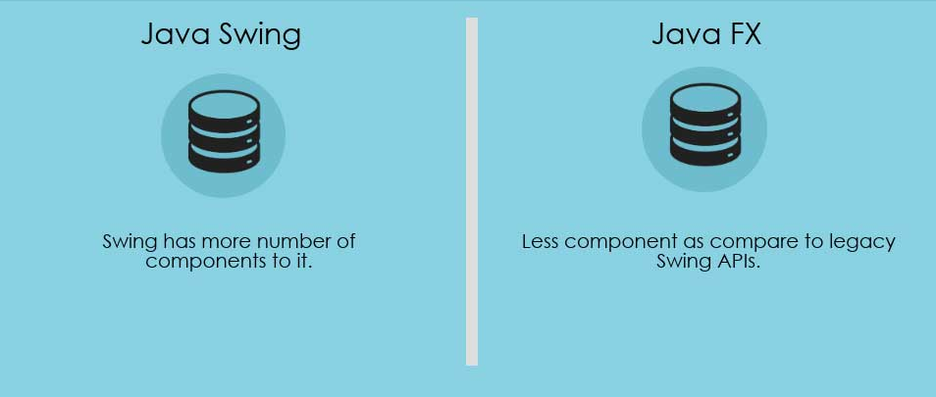

Slide 15
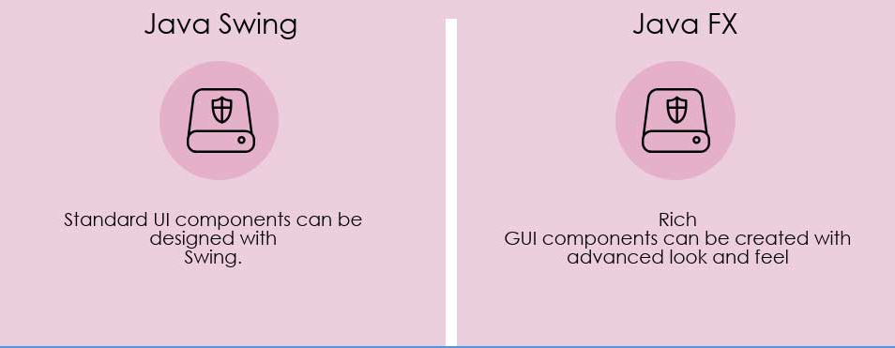

Slide 16
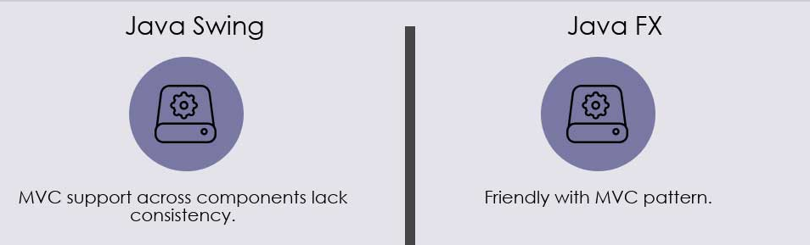

Slide 17
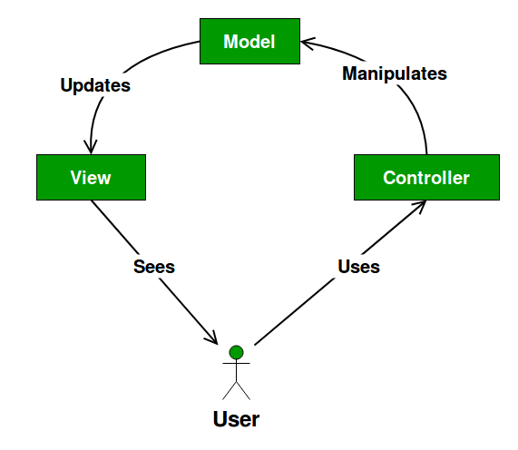
What is MVC?
The Model contains only the pure application data, it contains no logic describing how to present the data to a user.
The View presents the model’s data to the user. The view knows how to access the model’s data, but it does not know what this data means or what the user can do to manipulate it.
The Controller exists between the view and the model. It listens to events triggered by the view (or another external source) and executes the appropriate reaction to these events. In most cases, the reaction is to call a method on the model. Since the view and the model are connected through a notification mechanism, the result of this action is then automatically reflected in the view.

Slide 18
Advantages + Disadvantages
Multiple developers can work simultaneously on the model, controller and views.
MVC enables logical grouping of related actions on a controller together. The views for a specific model are also grouped together.
Models can have multiple views.
The framework navigation can be complex because it introduces new layers of abstraction and requires users to adapt to the decomposition criteria of MVC.
Knowledge on multiple technologies becomes the norm. Developers using MVC need to be skilled in multiple technologies.

Slide 19
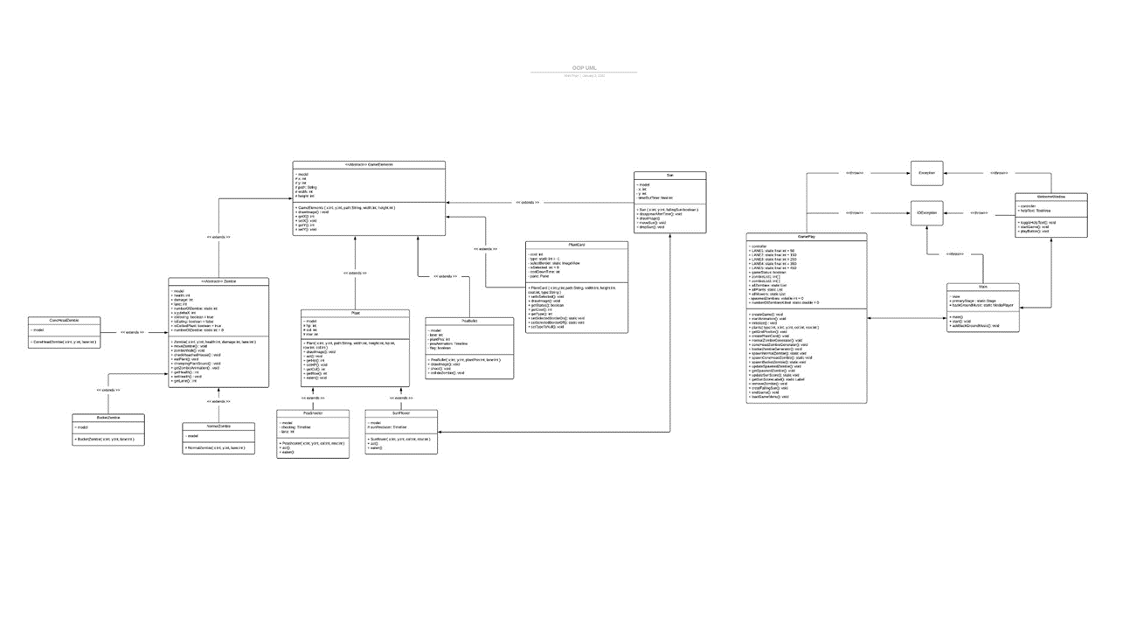

Slide 20
